Slide 1
CSE514 – Datamining Fall 2022 Matrix Factorization
Cynthia Ma
Department of Computer Science
Washington University in St. Louis
czma@wustl.edu

Slide 2
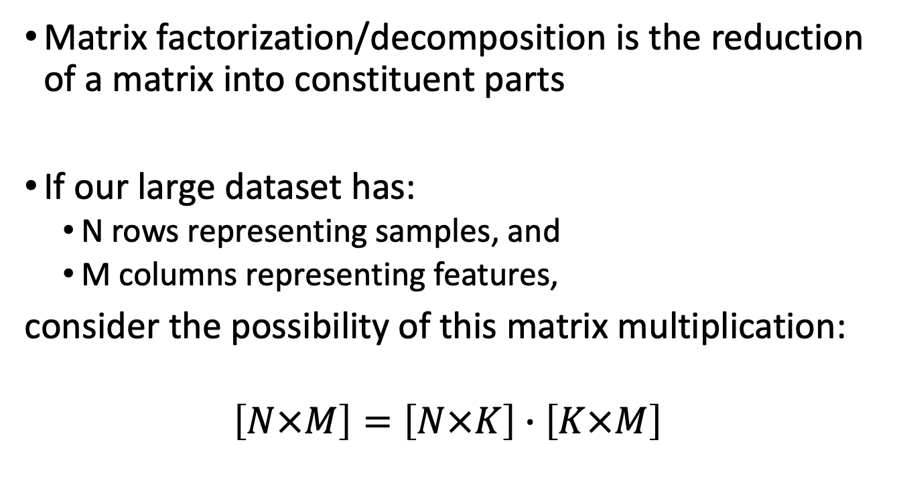
What is it?
Matrix factorization/decomposition is the reduction of a matrix into constituent parts
If our large dataset has:
N rows representing samples, and
M columns representing features,
consider the possibility of this matrix multiplication:
$$\left[N×M\right]=\left[N×K\right]∙\left[K×M\right]$$

Slide 3
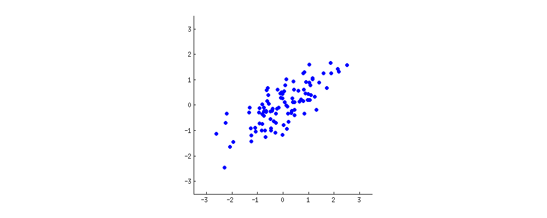
Principal Component Analysis
https://stats.stackexchange.com/q/140579

Slide 4
Principal Component Analysis
https://stats.stackexchange.com/q/140579

Slide 5
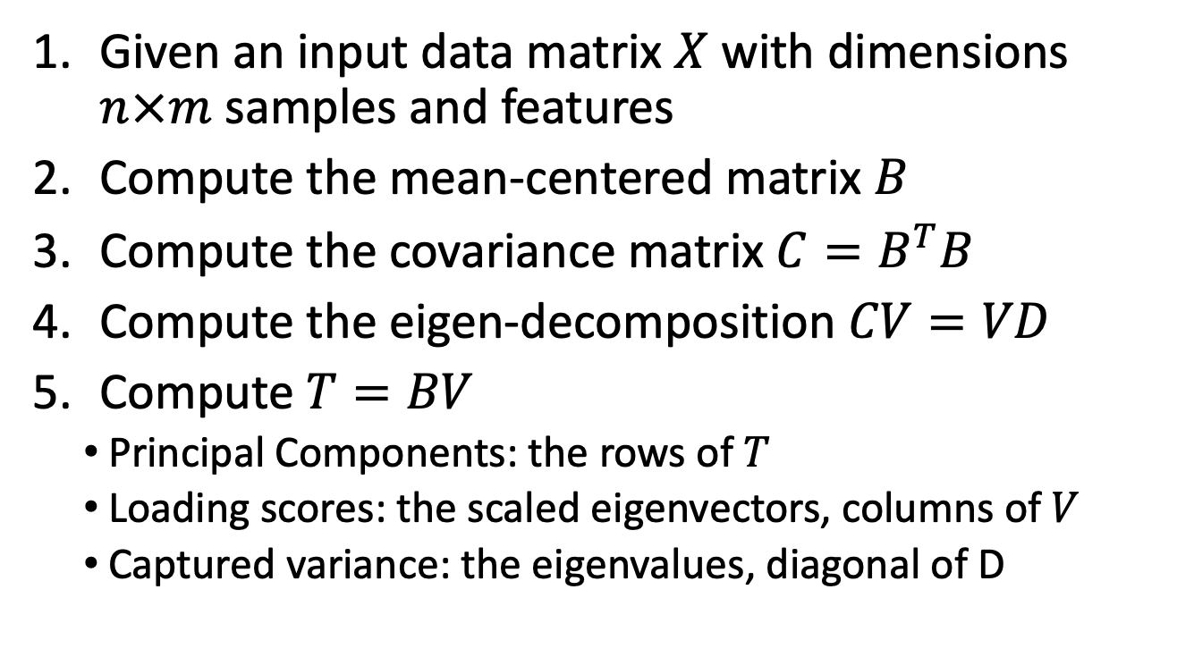
Matrix Factorization: PCA
Given an input data matrix $X$ with dimensions $n×m$ samples and features
Compute the mean-centered matrix $B$
Compute the covariance matrix $C=B^{T}B$
Compute the eigen-decomposition $CV=VD$
Compute $T=BV$
Principal Components: the rows of $T$
Loading scores: the scaled eigenvectors, columns of $V$
Captured variance: the eigenvalues, diagonal of D
Notes:
병찬
PCA 에서 principal component 는 선을 뜻하는것 같음
2번 단계: 데이터 중심을 새로운 곳으로 옮긴다.
프로그래밍 숙제에서…
Pca 를 트레이닝 데이터에만 적용해라
그리고 loading socre 를 관리해라

Slide 6
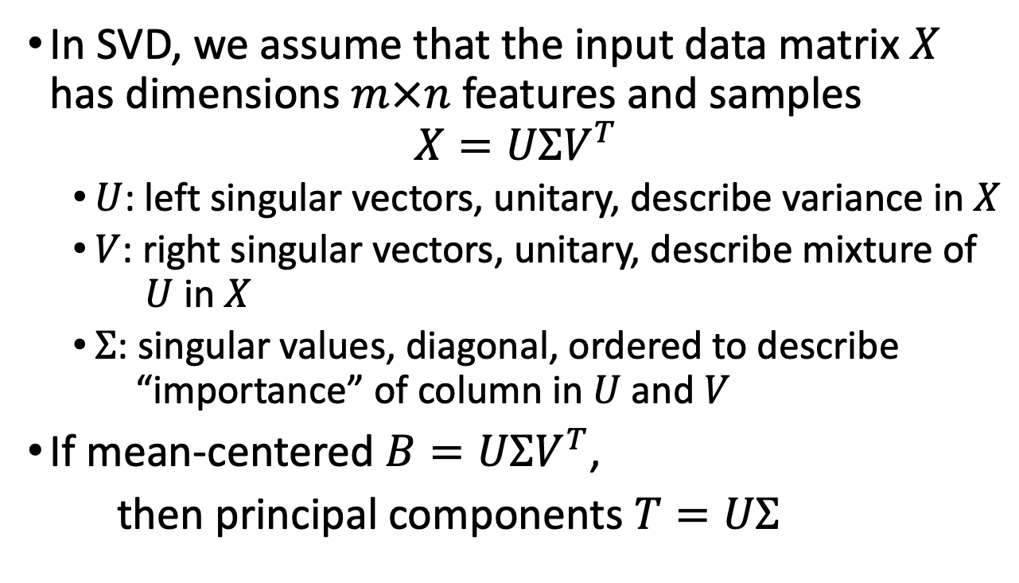
PCA from SVD
In SVD, we assume that the input data matrix $X$ has dimensions $m×n$ features and samples
$$X=UΣV^{T}$$
$U$: left singular vectors, unitary, describe variance in $X$
$V$: right singular vectors, unitary, describe mixture of $U$ in $X$
$Σ$: singular values, diagonal, ordered to describe “importance” of column in $U$ and $V$
If mean-centered $B=UΣV^{T}$,
then principal components $T=UΣ$
Notes:
병찬
여기서 m x n 이야기 할때에는 PCA 에서랑 반대이다. 한번 잘 생각해보자.

Slide 7
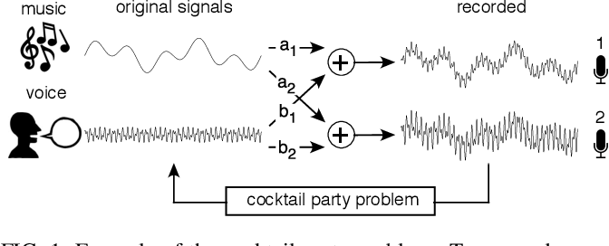
Independent Component Analysis
Shlens, Jonathon. “A Tutorial on Independent Component Analysis.” ArXiv abs/1404.2986 (2014)
Goal: separate a multi-variate signal into additive subcomponents to define a mixture matrix
Assumptions: at most one subcomponent is Gaussian
all subcomponents are statistically independent
number of “microphones” ≥ number of signal sources
Notes:
병찬,
여기서 부터는 개념만 알면 된다.
프로그램짜는걸 기대하는건 아니다.

Slide 8
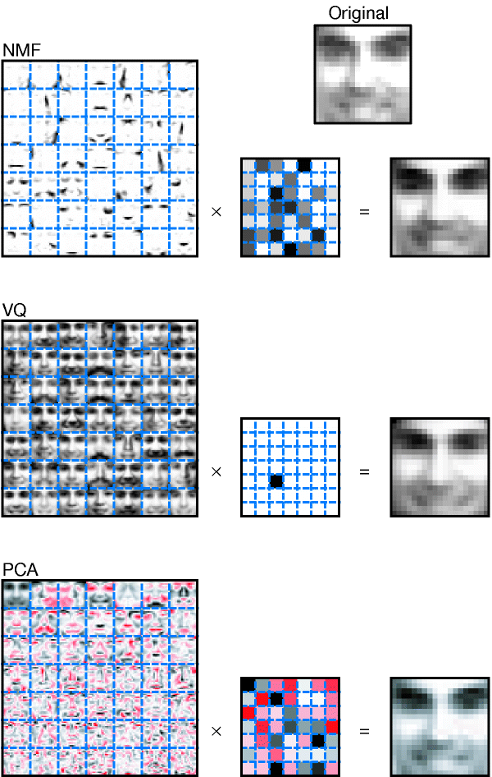
Non-negative Matrix Factorization
Goal: separate a non-negative input matrix into additive, non-negative factor matrices
Main advantage: interpretability of factors
Main disadvantage: results are not unique
https://doi.org/10.1038/44565
Notes:
병찬
왼쪽 pca 의 첫번째는 거의 원본 그림이랑 같다. 왜냐하면 거의 모든 특징을 다 가져가기 때문에.
오른쪽은 additive 한 결과만 가져가는거다.

Slide 9
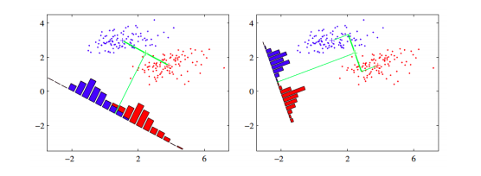
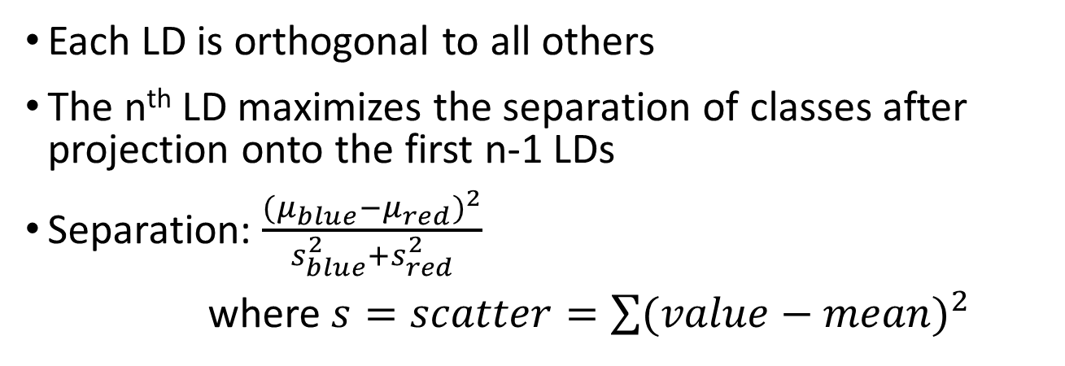
Linear Discriminant Analysis
Each LD is orthogonal to all others
The n^{th} LD maximizes the separation of classes after projection onto the first n-1 LDs
Separation: $\frac{{(μ_{blue}−μ_{red})}^{2}}{s_{blue}^{2}+s_{red}^{2}}$
where $s=scatter=\sum{{(value−mean)}^{2}}$
Notes:
병찬,
LDA…
오른쪽 처럼 하면 separability 가 높아짐. 당연한 이야기 -_-..

Slide 10
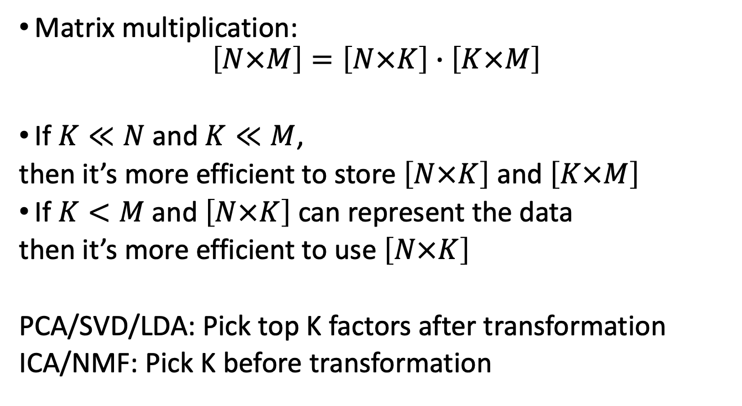
Dimension Reduction
Matrix multiplication:
$$\left[N×M\right]=\left[N×K\right]∙\left[K×M\right]$$
If $K≪N$ and $K≪M$,
then it’s more efficient to store $\left[N×K\right]$ and $\left[K×M\right]$
If $K<M$ and $\left[N×K\right]$ can represent the data
then it’s more efficient to use $\left[N×K\right]$
PCA/SVD/LDA: Pick top K factors after transformation
ICA/NMF: Pick K before transformation

Slide 11
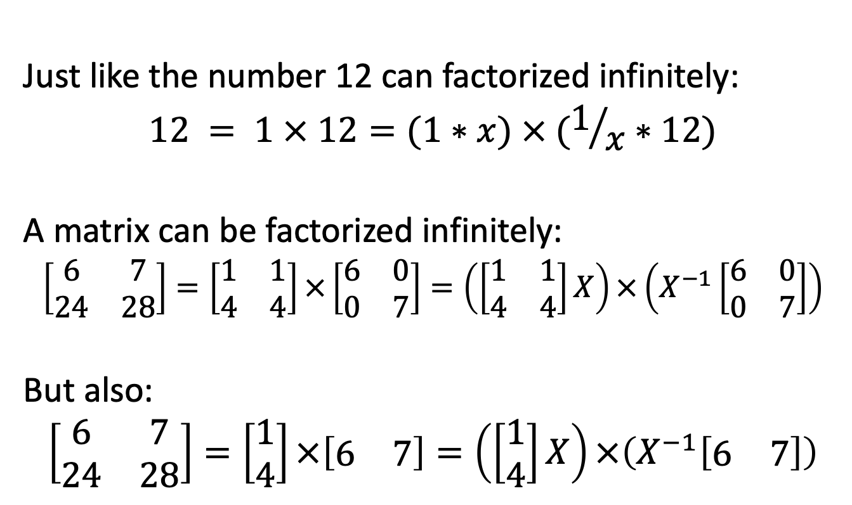
Need for constraints
Just like the number 12 can factorized infinitely:
$$12 = 1 × 12=(1∗x) × (1/x∗12)$$
A matrix can be factorized infinitely:
$$\left[\begin{matrix}6 & 7 \\ 24 & 28\end{matrix}\right]=\left[\begin{matrix}1 & 1 \\ 4 & 4\end{matrix}\right]×\left[\begin{matrix}6 & 0 \\ 0 & 7\end{matrix}\right]=\left(\left[\begin{matrix}1 & 1 \\ 4 & 4\end{matrix}\right]X\right)×\left(X^{−1}\left[\begin{matrix}6 & 0 \\ 0 & 7\end{matrix}\right]\right)$$
But also:
$$\left[\begin{matrix}6 & 7 \\ 24 & 28\end{matrix}\right]=\left[\begin{matrix}1 \\ 4\end{matrix}\right]×\left[\begin{matrix}6 & 7\end{matrix}\right]=\left(\left[\begin{matrix}1 \\ 4\end{matrix}\right]X\right)×\left(X^{−1}\left[\begin{matrix}6 & 7\end{matrix}\right]\right)$$

Slide 12
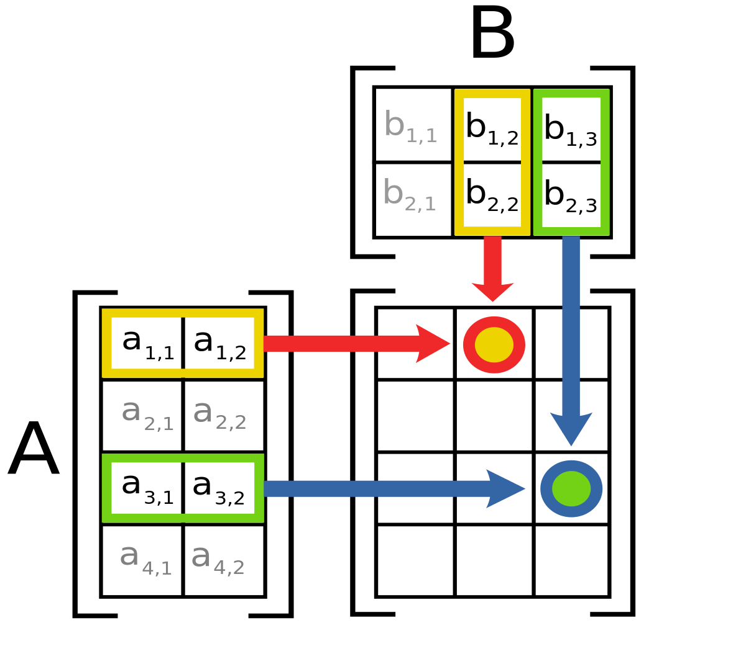
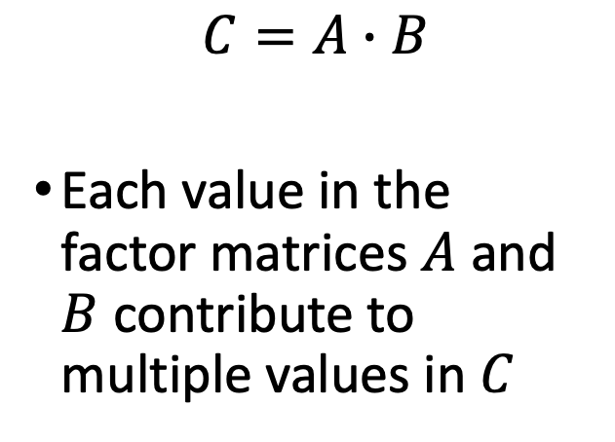
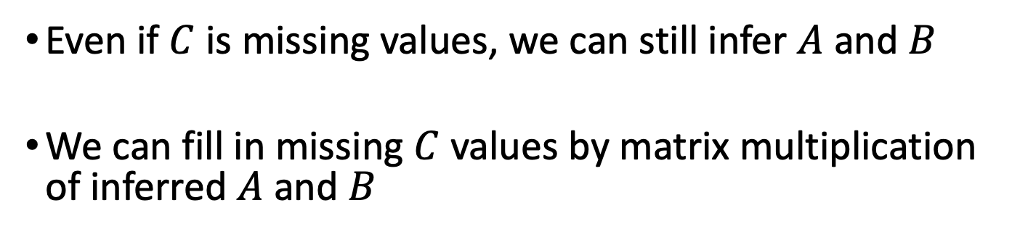
Matrix Factorization Imputation
$$C=A∙B$$
Each value in the factor matrices $A$ and $B$ contribute to multiple values in $C$
Even if $C$ is missing values, we can still infer $A$ and $B$
We can fill in missing $C$ values by matrix multiplication of inferred $A$ and $B$
Notes:
병찬
오른쪽 행렬에서 구멍이 뚫린게 미싱 value 인데 그걸 행렬 연산을 이용해서 계산해낼수 있다. 그런이야기임.

Slide 13
Netflix Recommendations
https://sifter.org/~simon/journal/20061211.html
Netflix provided 100M ratings (from 1 to 5) of 17K movies by 500K users as (User, Movie, Rating) triplets
Ex. (105932,14002,3)
For some triplet (User,Movie,?) not in the database, tell me what the Rating would be, i.e. predict how the given User would rate the given Movie so Netflix can decide whether or not to recommend it
Notes:
병찬,
또 카훗..

